Slide 1
Dapr Documentation Diagrams
This deck is used to draw the diagrams in the Dapr documentation
It is strongly recommended that you draw diagrams in this PPT deck for consistency and for future updates.
For example, if a new API is added, then the building blocks slide is updated and the corresponding image is saved to the docs repo in the /images folder
See the guidance on how to draw and save diagrams. Where possible use the list of provided icons.
If you add a diagram or a copied image into the docs, include it into this deck under the corresponding heading.
For example, Concepts, State management, or Pub/Sub

Slide 2







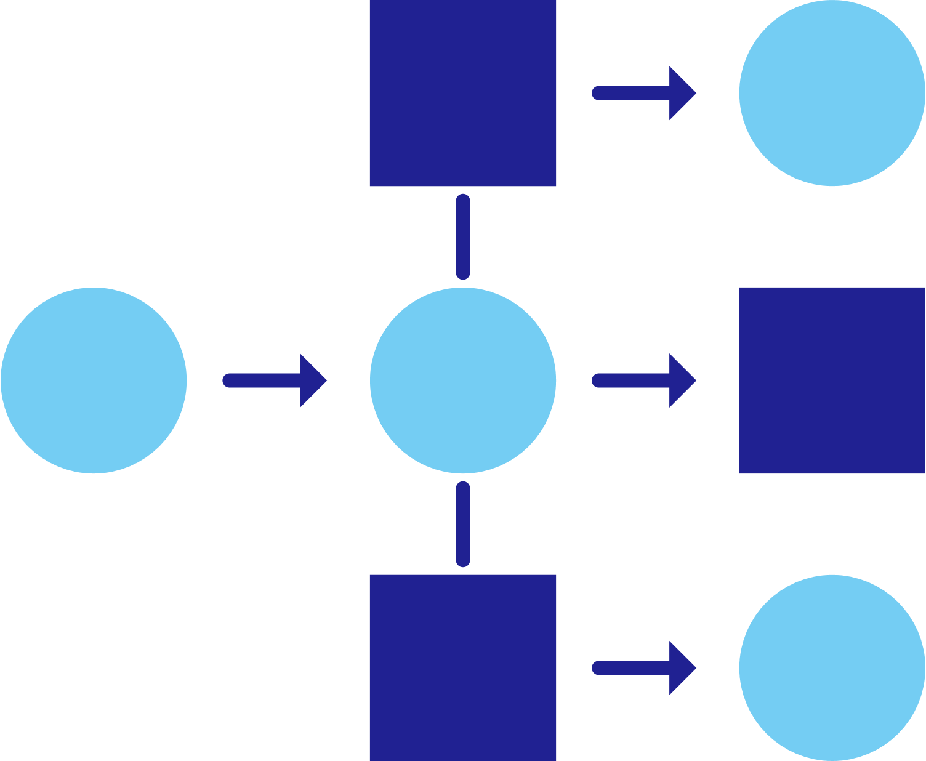













Icons
Encryption
User
Configuration
Key/secret
Blue logo
(preferred)
Black logo
White logo
Service
invocation
State
management
Publish and subscribe
Resource bindings
and triggers
Actors
Observability
Secrets
Configuration
App 1
App 2
App 3
App 4
Sidecar
Cloud
Edge
Self-hosted

Slide 3
Building diagrams
Apps and services are represented by a hexagon with shadow
App title is in Segoe UI Semibold
When more than one application is present in a diagram, alternate hexagon colors
The Dapr sidecar is represented by a white hexagon with the Dapr logo
Sidecar icon can be in any corner if needed, although the bottom right is preferred
Arrows connecting applications is 2.25pt weight, #202192 color
Always use right-angle turns and not curves when connecting items that are not inline with each other
My App
Your App

Slide 4
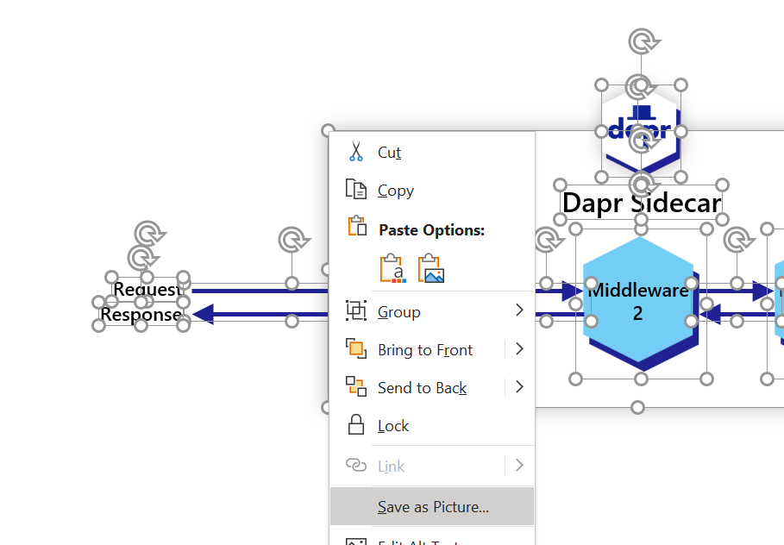
How to save a diagram – Approach 1
Select/drag over the entire diagram, not including the slide title
Right click (or use the right click key on your keyboard)
Select “Save as Picture”
Save as a PNG

Slide 5
How to save a diagram – Approach 2
An alternative approach is to “present” the slide from the deck, do a “selected area” screen capture (excluding any title) and save this as a PNG file
Ensure that you do not simply capture the selected area without presenting since this can result in red-squiggles for unknown words. Like this Squiggly lines in screenshots/diagrams · Issue #2222 · dapr/docs (github.com)

Slide 6
Dapr Diagrams

Slide 7
Concepts

Slide 8
Dapr building blocks
Service-to- service invocation
State management
Publish and subscribe
Bindings
(input/output)
Actors
Observability
Secrets
Configuration
Perform direct, secure, service-to-service method calls
Create long running, stateless and stateful services
Secure, scalable messaging between services
Trigger code through events from a large array of inputs
Input and output bindings to external resources including databases and queues
Encapsulate code and data in reusable actor objects as a common microservices design pattern
See and measure the message calls across components and networked services
Securely access secrets from your application
Access application configuration and be notified of updates

Slide 9
Microservice building blocks
HTTP API
gRPC API
Service-to-service invocation
State management
Publish and subscribe
Resource bindings and triggers
Actors
Observability
Secrets
Configuration

Slide 10
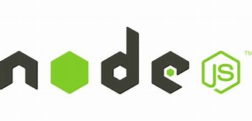

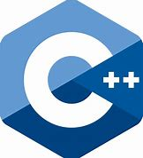










Application code
Microservices written in
Microservices written in
Any code or framework…
HTTP API
gRPC API
Service-to-service invocation
State management
Publish and subscribe
Resource bindings and triggers
Actors
Observability
Secrets
Configuration
Any cloud of edge infrastructure
virtual or
physical machines

Slide 11
Sidecar model
Application
Dapr sidecar
My App
Dapr API
HTTP/gRPC
POST http://localhost:3500/v1.0/invoke/cart/method/neworder
GET http://localhost:3500/v1.0/state/inventory/item67
POST http://localhost:3500/v1.0/publish/shipping/orders
GET http://localhost:3500/v1.0/secrets/keyvault/password

Slide 12







Dapr Components
Dapr in self-hosted Docker mode
State Stores
dapr run myapp
Launch application
Launch sidecar process
Set env variables
PubSub
Brokers
Actor
placement
Placement
Create mapping table of actor instances
Bindings
& Triggers
My App
Zipkin
tracing
Use components
Zipkin
Send distributed tracing
Secret Stores
Redis
state store
Redis
Save and retrieve state
Publish and subscribe to messages
Observability
Local dev machine or virtual machine
Configuration

Slide 13


Cluster of virtual/physical machines
VM 2
Dapr Components
VM 1
VM 3
Service A
Service B
State Stores
PubSub
Brokers
Consul agent server (leader)
Consul agent server (follower)
Consul agent server (follower)
Consul used for DNS name resolution
Bindings
& Triggers
Actor
placement
Actor
placement
Actor
placement
Placement
Create mapping table of actor instances
Placement
Placement
Secret Stores
Cert authority
& identity
Cert authority
& identity
Cert authority
& identity
Sentry
Sentry
Sentry
Observability
Assign Spiffe identity
Manage mTLS between services
File store for
certificates
Configuration

Slide 14


Dapr Components
Operator
Deploys and manages Dapr
State Stores
Pod
Pod
Pod
Pod
PubSub
Brokers
Actor partition placement
Dapr
runtime
injector
Cert authority
and identity
Update component
changes
Placement
Injector
Sentry
Operator
Bindings
& Triggers
Create mapping table of actor instances to pods
Inject Dapr sidecar into annotated pods
Inject env variables
Assign Spiffe identity
Manage mTLS between services
Manage component updates
Manage Kubernetes
service endpoints
Pod
Secret Stores
My App
Observability
Readiness and Liveness probe on healthz API to determine Dapr health state
Kubelet
Use components
Configuration
Any cloud or edge infrastructure

Slide 15
Dapr on Kubernetes
Dapr Components
Operator
Deploys and manages Dapr
State Stores
Pod
Pod
Pod
Pod
PubSub
Brokers
Actor partition placement
Dapr
runtime
injector
Cert authority
and identity
Update component
changes
Placement
Injector
Sentry
Operator
Bindings
& Triggers
Create mapping table of actor instances to pods
Inject Dapr sidecar into annotated pods
Inject env variables
Assign Spiffe identity
Manage mTLS between services
Manage component updates
Manage Kubernetes
service endpoints
Pod
Secret Stores
My App
Observability
Readiness and Liveness probe on healthz API to determine Dapr health state
Kubelet
Use components
Configuration
Any cloud or edge infrastructure

Slide 16
Dapr applications
Service A
State
Management
Service
Invocation
App A
PubSub
Messaging
Bindings
& Triggers
Secret
Management
Virtual
Actors
Service B
Observability
Configuration

Slide 17




















Dapr components
State
Stores
AWS
DynamoDB
Azure
CosmosDB
Firebase
Redis
Cassandra
PubSub
Brokers
AWS
SQS
Azure
Service Bus
GCP
Pub/Sub
Redis
RabbitMQ
My App
Bindings
& Triggers
AWS
S3
Azure
Storage
GCP
Storage
Twilio
Kafka
Swappable YAML files with
resource connection details
Over 90 components available
Create components for your resource at: github.com/dapr/components-contrib
Secret
Stores
AWS
Secrets Manager
Azure
KeyVault
GCP
Secret Manager
HashiCorp
Vault
Kubernetes
Secret
Observability
Prometheus
AppInsights
Zipkin
Jaeger

Slide 18
API
http/gRPC
API
(http/gRPC)
Building block
Pub/Sub
Building block
State Management
Component
Component
…Others
Component
Component
API
(HTTP/gRPC)
Component
Component
Building Block
Component
Component
Secrets

Slide 19
Security Concepts

Slide 20

Service access policies (Endpoint allow, deny ACLs)
Pub/Sub topic access policies
(Topic allow, deny ACLs)
Config
Service A
Service B
API Token
Authentication
mTLS encryption
API Token
Authentication
Notes:
Service A makes an http/gRPC call meant for Service B. The call goes to the local Dapr sidecar.
Dapr discovers Service B’s location using the name resolution component installed for the given hosting platform.
Dapr forwards the message to Service B’s Dapr sidecar
Note: All calls between Dapr sidecars go over gRPC for performance. Only calls between services and Dapr sidecars are either HTTP or gRPC
Service B’s Dapr sidecar forwards the request to the specified endpoint (or method) on Service B. Service B then runs its business logic code.
Service B sends a response to Service A. The response goes to Service B’s sidecar.
Dapr forwards the response to Service A’s Dapr sidecar.
Service A receives the response.

Slide 21


API Allow ACLs
Service
invocation
API access policies (allowed ACLs)
State
management
Config
Service
Publish/
subscribe
Bindings
…
Others

Slide 22


Read existing root/issuer cert
OR Create self-signed cert
Process
Cert authority
and identity
Sentry
Filesystem
Request Workload Certificate
Dapr API
mTLS
Dapr API
Service A
Service B
HTTP or gRPC
Secured, encrypted communication
HTTP or gRPC
Process
Process
Process
Process
Inject Trust Anchors
(Root Cert)
(optional)
Operator brings existing root and issuer certs
Operator

Slide 23
1
Read existing root/issuer cert
OR Create self-signed cert
Pod
(optional)
Operator brings existing root and issuer certs
Cert authority
and identity
Sentry
Kubernetes
Secrets
Request Workload Certificate
Operator
Pod A
Pod B
Dapr API
mTLS
Dapr API
Service A
Service B
HTTP or gRPC
Secured, encrypted communication
HTTP or gRPC
Inject Trust Anchors
(Root Cert)
Pod
Read Root Cert
Dapr
runtime
injector
Injector

Slide 24
Dapr Components
Operator
Deploys and manages Dapr
State Stores
Pod
Pod
Pod
Pod
PubSub
Brokers
Actor partition placement
Dapr
sidecar
injector
Cert authority
and identity
Update component
changes
Placement
Injector
Sentry
Operator
Bindings
& Triggers
Create mapping table of actor instances to pods
Inject Dapr sidecar into annotated pods
Inject env variables
Assign Spiffe identity
Manage mTLS between services
Manage component updates
Manage Kubernetes
service endpoints
Pod
Secret Stores
My App
Observability
Readiness and Liveness probe on healthz API to determine Dapr health state
Kubelet
Use components
Configuration
Any cloud or edge infrastructure

Slide 25






1
Dapr control plane
Pod
Pod
Pod
Pod
state store
Actor partition placement
Dapr
sidecar
injector
Cert authority
and identity
Update component
changes
8
Placement
Injector
Sentry
Operator
Encrypted State
4
namespace: dapr-system
namespace: Redis
Component scope policy
2
3
mTLS
Service access policy
Pub/Sub topic access policy
5
API access policy
(state management and secrets
1
JWT
API Token Authentication
Secret access policy
Ingress
6
SSL
Service A
Service B
secrets
7
namespace: default
namespace: A
namespace: B
Identity control plane for distributed systems
X.509 cert
Jason Web Token
mTLS - Mutual authentication

Slide 26
Observability Concepts

Slide 27


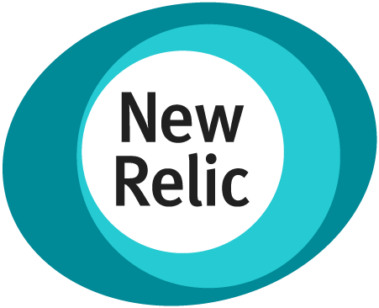

Backend Monitoring Tools
Visualize
And more…
Jaeger
Service A
Service A
W3C tracing context
Service B
W3C tracing context
Service C
W3C tracing context
Service invocation
Service B
Service C
Publish
Subscribe
Pub/Sub component
Notes:
Service A makes an http/gRPC call meant for Service B. The call goes to the local Dapr sidecar.
Dapr discovers Service B’s location using the name resolution component installed for the given hosting platform.
Dapr forwards the message to Service B’s Dapr sidecar
Note: All calls between Dapr sidecars go over gRPC for performance. Only calls between services and Dapr sidecars are either HTTP or gRPC
Service B’s Dapr sidecar forwards the request to the specified endpoint (or method) on Service B. Service B then runs its business logic code.
Service B sends a response to Service A. The response goes to Service B’s sidecar.
Dapr forwards the response to Service A’s Dapr sidecar.
Service A receives the response.

Slide 28


Backend Monitoring Tools
Visualize
Backend Monitoring Tools
Your tool of choice
Service A
Service A
Service B
W3C tracing context
Service C
Service invocation
Collector
W3C tracing context
W3C tracing context
Service B
Service C
Publish
Subscribe
Pub/Sub component
Notes:
Service A makes an http/gRPC call meant for Service B. The call goes to the local Dapr sidecar.
Dapr discovers Service B’s location using the name resolution component installed for the given hosting platform.
Dapr forwards the message to Service B’s Dapr sidecar
Note: All calls between Dapr sidecars go over gRPC for performance. Only calls between services and Dapr sidecars are either HTTP or gRPC
Service B’s Dapr sidecar forwards the request to the specified endpoint (or method) on Service B. Service B then runs its business logic code.
Service B sends a response to Service A. The response goes to Service B’s sidecar.
Dapr forwards the response to Service A’s Dapr sidecar.
Service A receives the response.

Slide 29
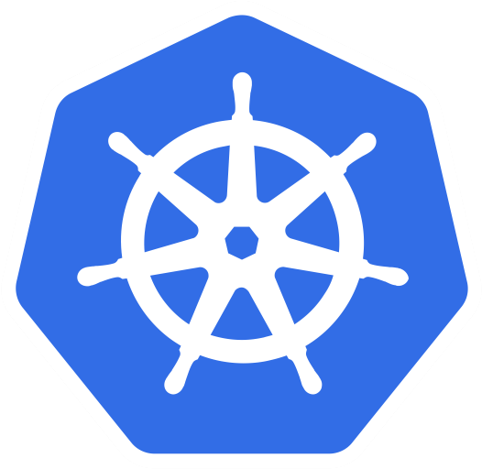



Health
Check
Metrics
Logs
INFO
WARNING
ERROR
GET http://localhost:3500/v1.0/healthz
Endpoint
Sidecar
Notes:
Service A makes an http/gRPC call meant for Service B. The call goes to the local Dapr sidecar.
Dapr discovers Service B’s location using the name resolution component installed for the given hosting platform.
Dapr forwards the message to Service B’s Dapr sidecar
Note: All calls between Dapr sidecars go over gRPC for performance. Only calls between services and Dapr sidecars are either HTTP or gRPC
Service B’s Dapr sidecar forwards the request to the specified endpoint (or method) on Service B. Service B then runs its business logic code.
Service B sends a response to Service A. The response goes to Service B’s sidecar.
Dapr forwards the response to Service A’s Dapr sidecar.
Service A receives the response.

Slide 30
Service Invocation Building Block

Slide 31
Service Invocation Overview
3
1
mTLS encryption
4
Service A
Service B
7
6
5
Name
resolution
2
Name resolution
component
Notes:
Service A makes an http/gRPC call meant for Service B. The call goes to the local Dapr sidecar.
Dapr discovers Service B’s location using the name resolution component installed for the given hosting platform.
Dapr forwards the message to Service B’s Dapr sidecar
Note: All calls between Dapr sidecars go over gRPC for performance. Only calls between services and Dapr sidecars are either HTTP or gRPC
Service B’s Dapr sidecar forwards the request to the specified endpoint (or method) on Service B. Service B then runs its business logic code.
Service B sends a response to Service A. The response goes to Service B’s sidecar.
Dapr forwards the response to Service A’s Dapr sidecar.
Service A receives the response.

Slide 32
Service A
Instance 1
Round robin load balancing
Service A
Service A
Instance 2
Service A
Instance 3

Slide 33
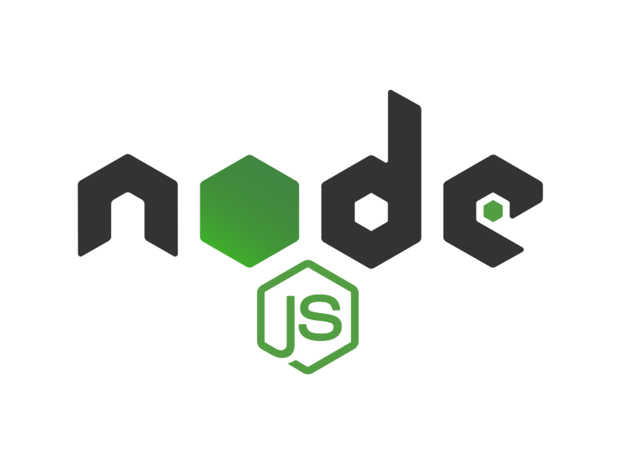

Service Invocation Overview Example
Local Machine
POST
http://localhost:3500/v1.0/invoke/nodeapp/method/neworder
POST
http://10.0.0.2:8000/neworder
{"orderid":"123","data":"item1"}
{"orderid":"123","data":"item1"}
pythonapp
1
Service A
Sidecar
3
Service B
Sidecar
4
nodeapp
7
6
5
2
Name resolution
component (mDNS)
Notes:
Service A makes an http/gRPC call meant for Service B. The call goes to the local Dapr sidecar.
Dapr discovers Service B’s location using the name resolution component installed for the given hosting platform.
Dapr forwards the message to Service B’s Dapr sidecar
Note: All calls between Dapr sidecars go over gRPC for performance. Only calls between services and Dapr sidecars are either HTTP or gRPC
Service B’s Dapr sidecar forwards the request to the specified endpoint (or method) on Service B. Service B then runs its business logic code.
Service B sends a response to Service A. The response goes to Service B’s sidecar.
Dapr forwards the response to Service A’s Dapr sidecar.
Service A receives the response.

Slide 34
State Management Building Block

Slide 35

state store component
Key | Value
myApp-weapon | "Death Star"
myApp-planet | { "name": "Tatooine" }
myApp
POST
http://localhost:3500/v1.0/state/myStateStore
GET
http://localhost:3500/v1.0/state/myStateStore/planet
POST
http://localhost:3500/v1.0-alpha1/state/myStateStore/query
[{
"key": "weapon",
"value": "Death Star"
},
{
"key": "planet",
"value": {
"name": "Tatooine"
}
}]
{
"query": {
"filter": {
"EQ": {"value.name": "Tatooine" }
}
}
}
200 OK
{"name":"Tatooine"}
200 OK
{
"results": [{
"key": "planet",
"value": {
"name": "Tatooine"
}
}]
}
200 OK

Slide 36
GET
http://localhost:3500/v1.0/state/<store-name>/planet
{
"name": "Tatooine"
}
App
ID: dapr1
key | value
dapr1-weapon | "DeathStar"
dapr1-planet | { "name": "Tatooine" }
POST
http://localhost:3500/v1.0/state/<store-name>
[{
"key": "weapon",
"value": "DeathStar"
}, {
"key": "planet",
"value": {
"name": "Tatooine"
}
}]
State store of your choice

Slide 37
Application Configuration

Slide 38
Configurationcomponent
Key | Value
myApp-dbname | "database:connection"
myApp-dbpartitionId | "10"
myApp
GET
http://localhost:3500/v1.0/configuration/myconfigstore/dbname
200 OK
"database:connection"

Slide 39
Pub/Sub Building Block

Slide 40
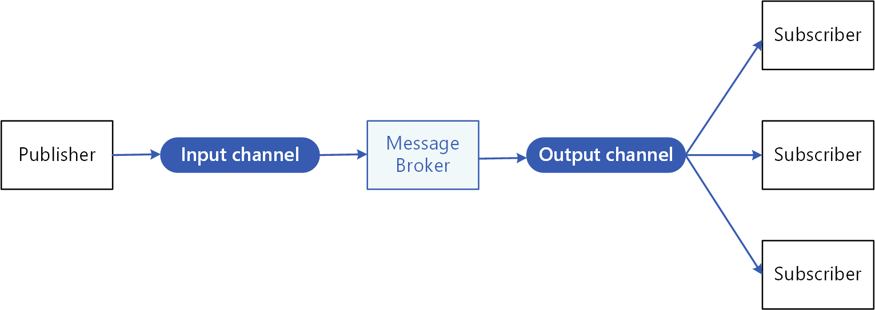

Slide 41




Publish
Pub/Sub
Components
Subscribe
Cart
Shipping
component
configuration
component
configuration
Email
component
configuration

Slide 42
Publish
Pub/Sub
Components
Subscribe
Cart
Shipping
Post
http://10.0.0.5:8005/order
Post
http://localhost:3500/v1.0/publish/pubsub/order
"data":{
"user":“JohnDoe",
"item":"ZeroDay"
}
"data":{
"user":“JohnDoe",
"item":"ZeroDay"
},
Email
Post
http://10.0.0.4:8004/order
"data":{
"user":“JohnDoe",
"item":"ZeroDay"
}

Slide 43

React
publisher
Node subscriber
Python subscriber
Publish
Subscribe
namespace-b
namespace-a

Slide 44

Pub/Sub Raw Messages
Dapr
publisher
Non-Dapr
subscriber
Raw
message
Pub/sub topic
Non-Dapr
publisher
Dapr
subscriber
Pub/sub topic
Raw
message

Slide 45
Publish
“pubsub”
component
Subscribe
pubapp
app1
Post
http://localhost:3500/v1.0/publish/pubsub/deathStarStatus
Post
http://10.0.0.5:5000/dsstatus
"data":{
“status":“Completed"
},
"data":{
“status":“Completed"
},

Slide 46
Actors Building Block

Slide 47
Actor Reentrancy
Coordinator
Actor
start work
start work
work complete
work complete
Worker Actor 1
Worker
Actor 2
Actor
Call local method
Notes:
Service A makes an http/gRPC call meant for Service B. The call goes to the local Dapr sidecar.
Dapr discovers Service B’s location using the name resolution component installed for the given hosting platform.
Dapr forwards the message to Service B’s Dapr sidecar
Note: All calls between Dapr sidecars go over gRPC for performance. Only calls between services and Dapr sidecars are either HTTP or gRPC
Service B’s Dapr sidecar forwards the request to the specified endpoint (or method) on Service B. Service B then runs its business logic code.
Service B sends a response to Service A. The response goes to Service B’s sidecar.
Dapr forwards the response to Service A’s Dapr sidecar.
Service A receives the response.

Slide 48
Actor Type hashing and broadcast with Placement service for each actor instance (partition)
Instance 1
Dapr
Runtime
ActorType MyActor1 | Dapr Instances (partitions)
ActorType MyActor2 | Dapr Instances (partitions)
Service code
Actor Type MyActor1
1
When a new Dapr instance is created, that hosts actors, it tells the Placement service the types of actor it can create. The partition services hashes this instance (partition)
Dapr - Placement service
Instance 2
Dapr
Runtime
ActorType MyActor1 | Dapr Instances (partitions)
ActorType MyActor2 | Dapr Instances (partitions)
ActorType MyActor1 | Dapr Instances (partitions)
ActorType MyActor2 | Dapr Instances (partitions)
Service code
Actor Type MyActor1
2
The Placement service broadcasts to all Dapr instances the list of Dapr instances (partitions) for each actor type which are cached
Instance 1
Dapr
Runtime
ActorType MyActor1 | Dapr Instances (partitions)
ActorType MyActor2 | Dapr Instances (partitions)
Service code
Actor Type MyActor2

Slide 49
Client code calling Actor 123 instance of type MyActor1
Instance 1
Dapr
Runtime
ActorType MyActor1 | Dapr Instances (partitions)
ActorType MyActor2 | Dapr Instances (partitions)
Service code
Actor Type MyActor1
Client code calls actor ID 123 for actor type MyActor1.
The Dapr instance hashes the request for ID 123 to a Dapr instance (partition) and looks this up in the local cache
1
Dapr - Placement service
Dapr
Runtime
ActorType MyActor1 | Dapr Instances (partitions)
ActorType MyActor2 | Dapr Instances (partitions)
Instance 2
Dapr
Runtime
Service code
Call Actor ID 123
ActorType MyActor1 | Dapr Instances (partitions)
ActorType MyActor2 | Dapr Instances (partitions)
ActorType MyActor1 | Dapr Instances (partitions)
ActorType MyActor2 | Dapr Instances (partitions)
Actor Type MyActor1
Actor ID 123 created
2
Client call for actor ID 123 sent to the Dapr instance to create the actor
Instance 1
Dapr
Runtime
ActorType MyActor1 | Dapr Instances (partitions)
ActorType MyActor2 | Dapr Instances (partitions)
Service code
Actor Type MyActor2

Slide 50
Secrets Building Block

Slide 51




Cloud Secret Stores
Google
Key Management
Azure
Key Vault
GET
http://localhost:3500/v1.0/secrets/vault/mysecret
Service A
mysecret “supersecret”

Slide 52
1
Pod
GET
http://localhost:3500/v1.0/secrets/kubernetes/mysecret
Service A
mysecret “supersecret”
Kubernetes
Secret Store

Slide 53
Cloud Secret Store
Azure
Key Vault
1
Pod
GET
http://localhost:3500/v1.0/secrets/vault/mysecret
Service A
mysecret “supersecret”
Pod
Managed Identity

Slide 54
Other

Slide 55
OAuth
OAuth
Server
App
token
header
OAuth Middleware
configuration

Slide 56
Middleware
Dapr Sidecar
Request
Middleware
1
Middleware
2
Middleware
3
My App
Response

